Slide 1
Hopping Robot Update X
Results

Slide 2
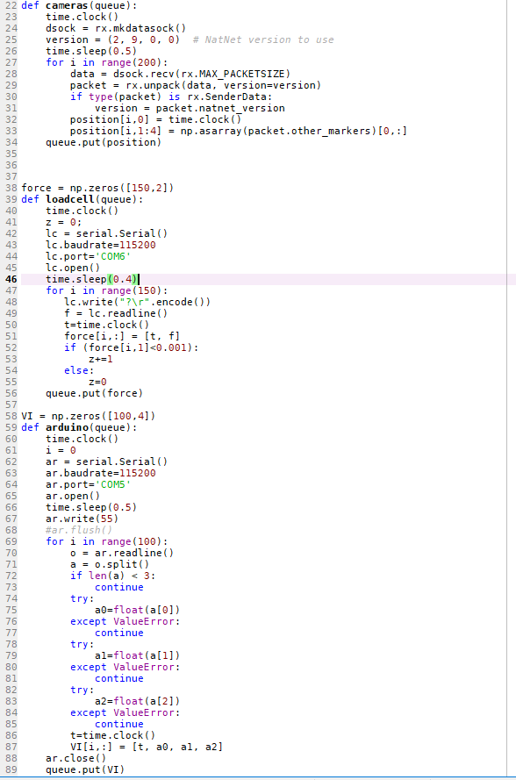
Jumping Data Collection
Position (of body)
Force
Current & Voltage
Encoder

Slide 3
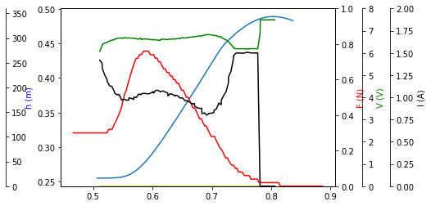
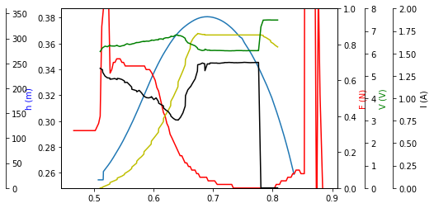
Single Jump
12 cm, 1:150 reduction
6 cm, 1:100 reduction

Slide 4
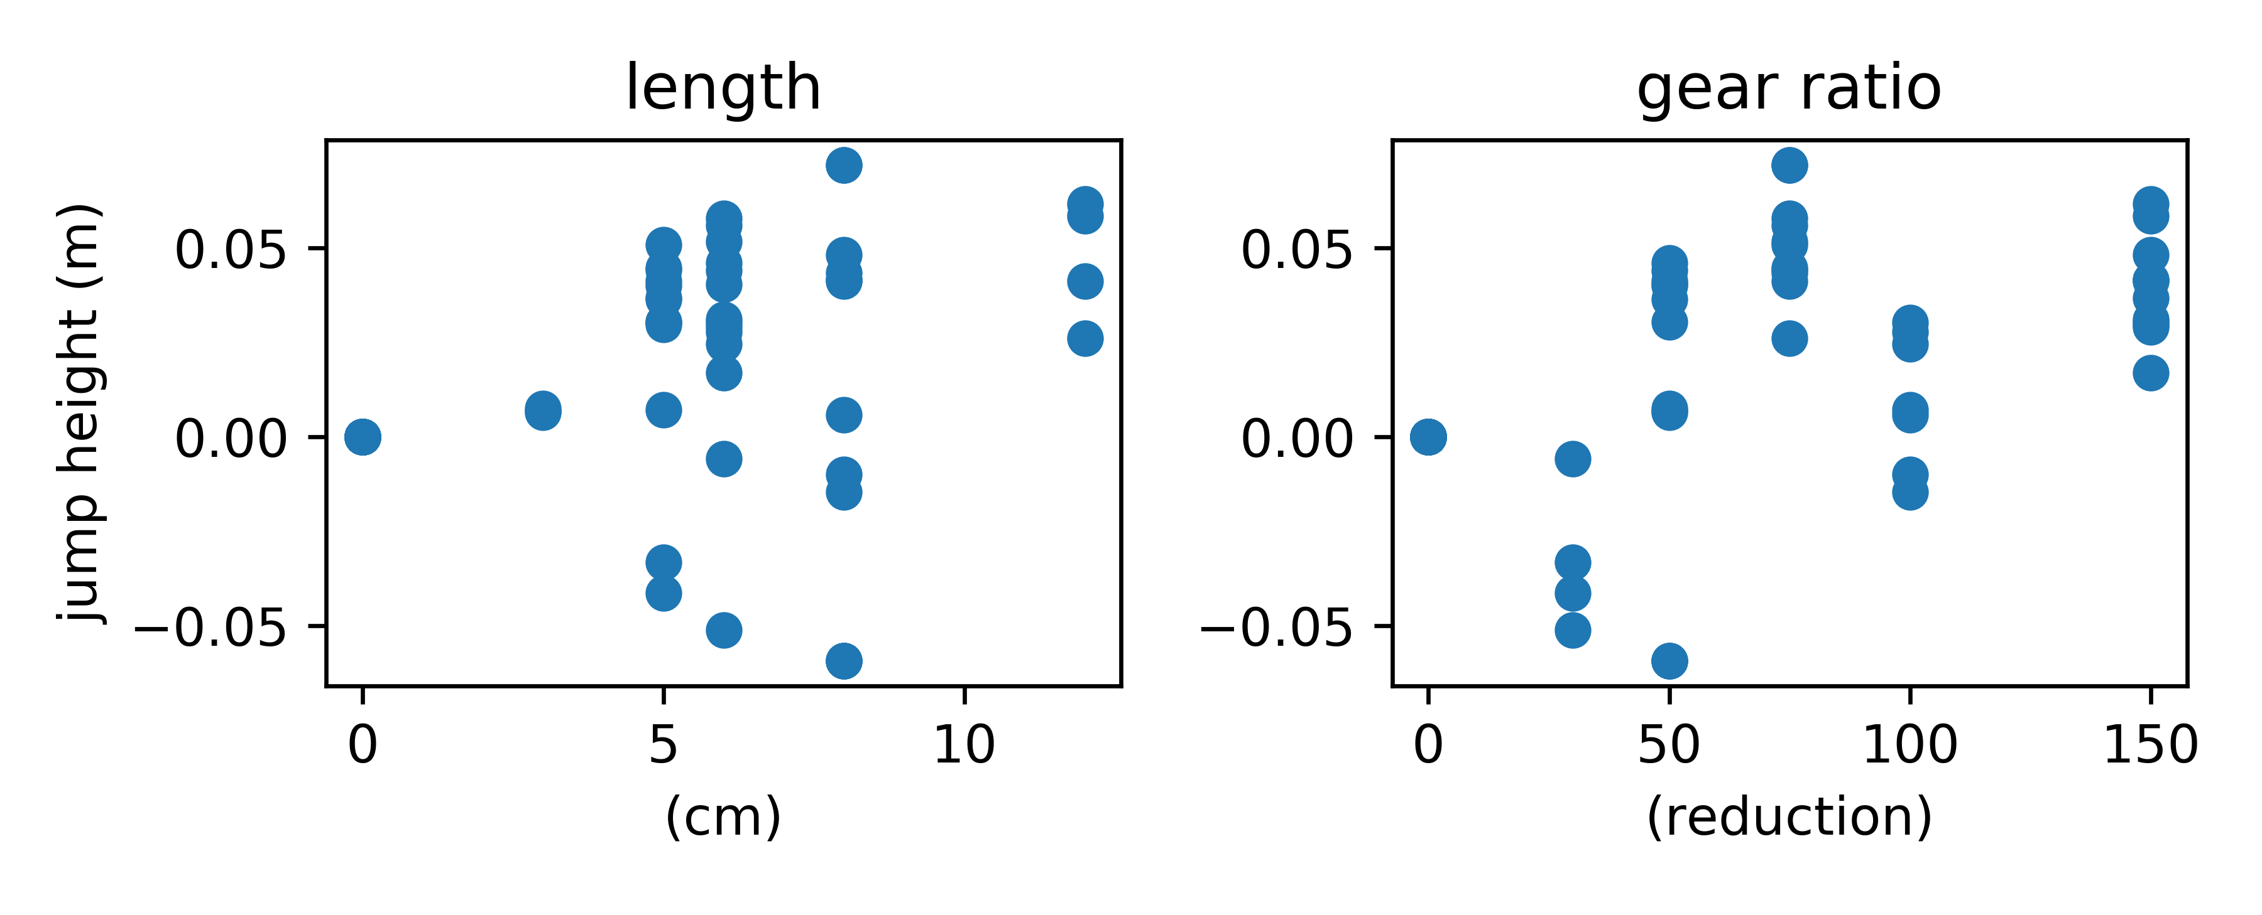
Jumping Results

Slide 5
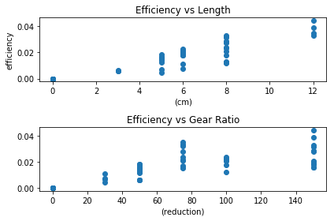
Jumping Results
Efficiency=PotentialEnergyOut/ElectricalEnergyIn

Slide 6
Simulation
Needs flexibility
Needs motor inertia and inductance

Slide 7




Motor Modeling

Slide 8
Current Objective
Present results, complete full Pynamics model
TODO
finish collecting motor constants
maybe verify motor
verify final pynamics sim
run final pynamics sim for all designs
Motor sim motor, design sim design, trends, sim trends
labeled diagram of system
frame by frame of one design

